Slide 1


AFRICAN AVIATION
TRANSFORMED
The Single African Air Transport Market (SAATM)
A PRESNTATION TO AESATA
Capt. Gilbert M. Kibe
SAATM – PIP Ambassador for Eastern Region
AFRICAN CIVIL AVIATION COMMISSION (AFCAC)

Slide 2
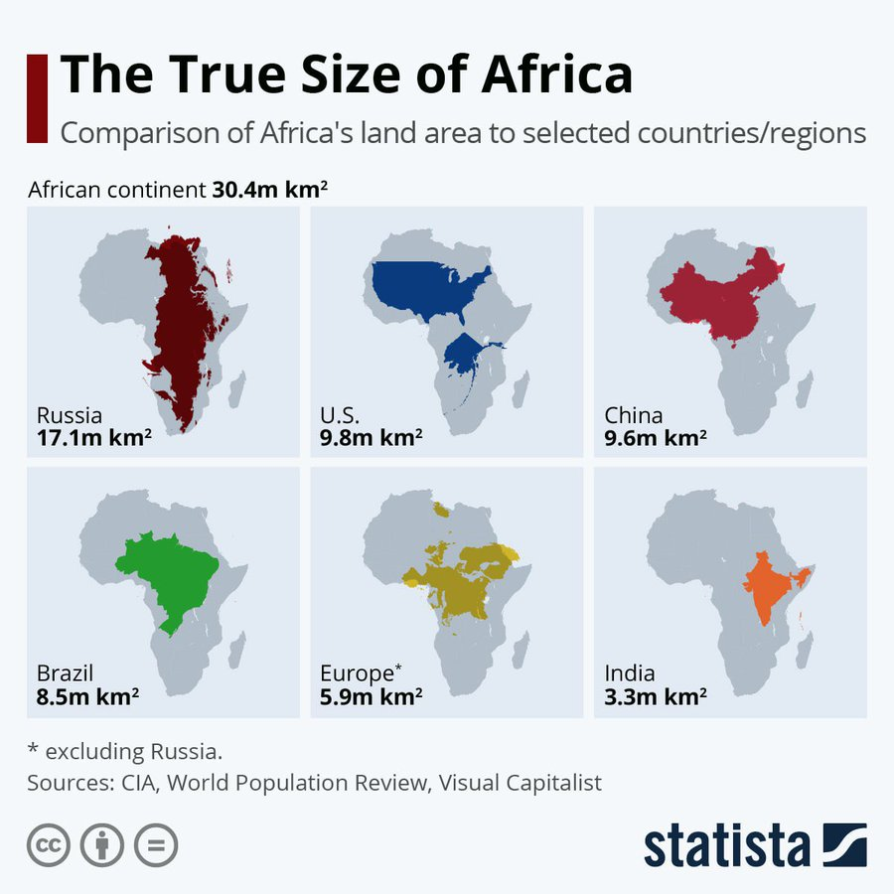

Slide 3




AFRICAN UNION FLAGSHIP PROJECTS
Encyclopedia Africana
Integrated High Speed Train Network
Formulation of an African Commodities Strategy
Great African Museum
SAATM
FMP
&
African
Passport
Silencing the Guns By 2020
Cyber Security
AfCFTA
Implementation of the Grand Inga Dam Project
An African Virtual And E-University
Establishment of an Annual African Economic Forum
Africa Outer Space Strategy
The Pan-African E-Network
Establishment of the African Financial Institutions
NATIONAL STAKEHOLDERS WORKSHOP - ABUJA - NIGERIA

Slide 4
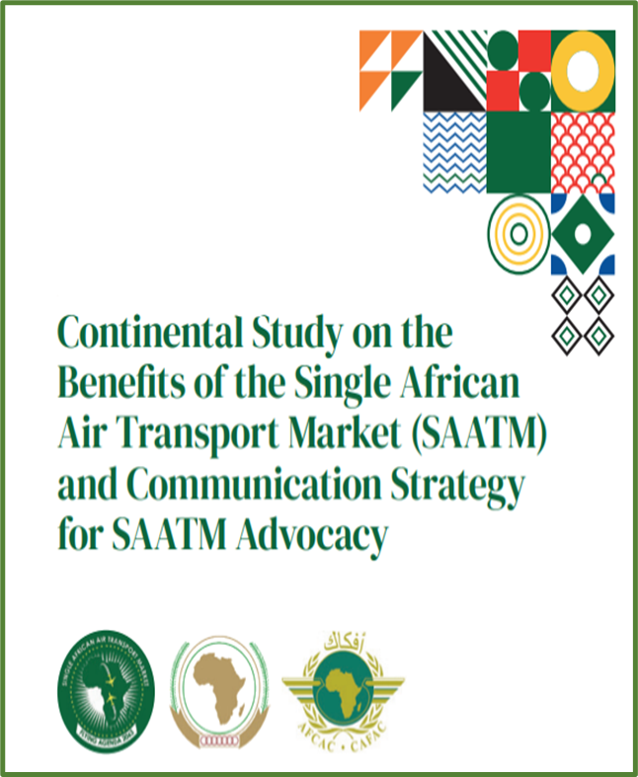
CONTINENTAL BENEFITS OF SAATM
Additional 588,750 jobs and US$ 4.2 billion additional GDP (0.17%)
Fare Reduction
Traffic Growth
Connectivity
Job Creation
fare will reduce by 26% overall, results in a total fare saving of US$ 1.46 billion per annum
Consumer surplus increase by US$ 2.85 billion
15,9 million additional passengers (31% increase).
6.7 million passenger increase in 35 SAATM States (representing 37% growth)
Expected that +145 additional City Pairs will be created (direct flights);
Shorter traveling time
96.440 jobs created in Aviation;
268.530 new jobs in tourism & additional 4 million tourists;
1.1% increase in trade within the continent (GDP)

Slide 5
Benefits of SAATM | Traffic Impacts
Growth in intra-Africa traffic by country
Additional traffic expected after 2-3 years
Overall growth of 51%
Additional 15.9 million passengers (from 31.2 million)
Growth forecasts for Central African Rep, Angola, Guinea-Bissau and Algeria
Source: InterVISTAS analysis.

Slide 6
INTRA AFRICAN CONNECTIVITY
Number of direct flights from EAC countries to Africa - 2023
Source : AFRAA

Slide 7
PASSENGER TRAFFIC AMONG THE EAC COUNTRIES
2017
BJM
MGQ
FIH
NBO
JUB
ORIGINS
BI ,CD, KE, RW, SO, SS, TZ, UG
Passengers: 4,862,535
Passenger Revenues: 486,086,201
KGL
DAR
BJM
2023
EBB
KGL
MGQ
FIH
DESTINATIONS
FIH
NBO
JUB
NBO
JUB
ORIGINS
BJM
BI ,CD, KE, RW, SO, SS, TZ, UG
Passengers: 7,502,248
Passenger Revenues: 693,714,442
KGL
DAR
DAR
MGQ
EBB
KGL
EBB
FIH
DESTINATIONS
JUB
NBO
BJM
DAR
MGQ
Source : Milanamos Planet Optim
EBB

Slide 8
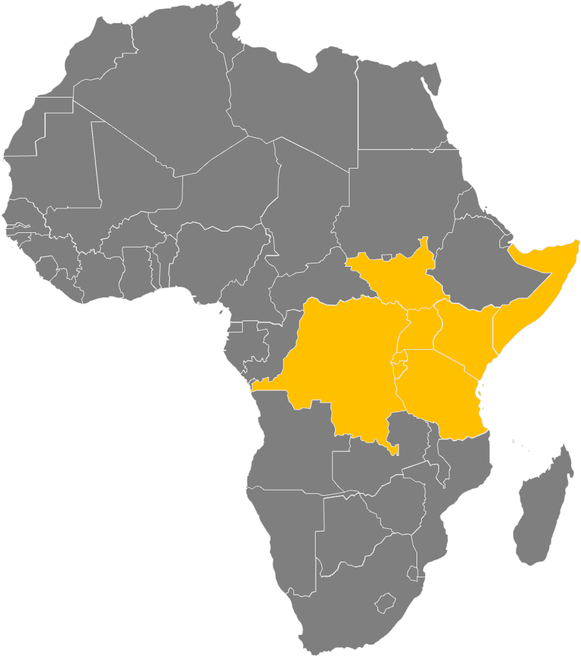
THE EAC COUNTRIES
83
Schedules and chartered airlines
196
Airports and airstrips
10.2 million
Passenger traffic to/from the EAC countries in 2023

Slide 9
The East African Community (EAC) Experience
Background
The One Network Area (ONA) was conceived in 2015 under the Northern Corridor Integration Project (NCIP).
The Northern corridor is the transport corridor linking the landlocked countries of Uganda, Rwanda, Burundi, and South Sudan to Kenya’s maritime port of Mombasa.
The transport corridor also serves the Democratic Republic of Congo and Northern Tanzania. The NCIP Project is intended to generate the sustainable political will necessary to Fastrack the implementation of the intended projects. Broadly speaking, the NCIP was meant to integrate the partner states economically.
Challenges that ONA sought to address (Rationale):
High roaming cost was an obstacle to the regional integration efforts
There was growth in regional (EAC) travel due to the opening of economies
Significant tariff differentials while roaming on different networks within the host country in EAC
Roaming Cross Border Services – Absence of Regulatory oversight single country or REC cannot tackle this issue alone
Weak/Limited Competitive Forces in the Roaming Market Segment
International roaming services involve multiple stakeholders (operators, regulators, taxation authorities) and a regional policy framework is paramount

Slide 10
The East African Community (EAC) Experience
Benefits
When ONA was implemented, there was an exponential increase in inbound and outbound roaming traffic that ranged from 200% to 950% across the region.
The increase in roaming traffic due to affordable tariffs brought about the following direct and indirect benefits:
  Reduced Cost of Doing business for all Member States
  Enhanced Regional Socio-Economic Integration
  Fast-Tracks the Regional Common Market
  Spurs other Economic Activities such as Trade and Services
  Increased Government Revenues from increased usage of ICT services

Slide 11
3. The European Union (EU) Experience
Background
Following the liberalisation of the European air transport market 30 years ago witnessed the emergence of Low Cost Carriers (LCCs) and this stimulated new traffic growth – but also took market share from mainline carriers, several of which reacted by creating their own low cost provider.
In 1998 the relative share of the LCC market segment in Europe was close to zero; by 2018, it was 30.3%, which corresponds to 9,100 average daily flights.
To achieve low operating costs per passenger and high aircraft productivity, LCCs typically offer point-to-point services on short haul routes with a single type fleet (B737, A320).
With a strong focus on cost, many LCCs operate a modern and fuel-efficient fleet with a comparatively low fuel burn per passenger kilometre and lower CO2 emissions.
At the outset, the growth of the LCCs was concentrated in Western Europe but with the enlargement of the European Union in 2004, LCCs progressively expanded into Central and Eastern Europe, stimulating strong growth in those emerging markets.
Although some LCCs have started to operate at large European hub airports, they tend to operate at less congested secondary airports and may decide to enter and exit new markets at comparatively short notice.
Source: Eurocontrol (with permission)

Slide 12
3. The European Union (EU) Experience
Today
Share of Low Cost Carriers in total European IFR flights (%)
Airline Group January-September 2022 Avg. daily flight (2022)% of operated flights in Europe (2022)
1. Ryanair Group 2,584 10.1%
2. easyJet Group 1,367 5.3%
3. Turkish Airlines 1,253 4.9%
4. Lufthansa Airlines 1,046 4.1%
5. Air France Group 945 3.7%
6. KLM Group 716 2.8%
7. Wizz Air Group 660 2.6%
8. British Airways Group 626 2.4%
9. Vueling 547 2.1%
10. SAS Group 520 2.0%
11. Eurowings Group 430 1.7%
12. Pegasus 423 1.7%
13. TUI Group 383 1.5%
14. Norwegian Group 341 1.3%
15. SWISS Group 332 1.3%
Source: Eurocontrol (with permission)

Slide 13
3. The European Union (EU) Experience

Slide 14

SAATM PILOT IMPLEMENTATION PROJECT
Launched under the theme “ACCELERATION OF AIR TRANSPORT LIBERALIZATION IN AFRICA TO IMPROVE CONTINENTAL CONNECTIVITY AND INTEGRATION”.
SAATM-PIP
SAATM-PIP
Goal One
Goal Two
Increase 5th freedom traffic rights operations across Africa from 14.5% to 30% by 2025
Increase inter-sectoral collaboration and synergies between air transport institutions and other sectors of the economy
SAATM-PIP
So far 21 States (54% of SAATM STATES) are on Board the SAATM-PIP

Slide 15

WHAT AFCAC IS DOING ON SAATM
Advocacy for all the AU States to join and Implement SAATM
Promoting the reduction of air transport Taxes, Fees and Charges (TFC) on African aviation.
Promoting new intra-Africa routes traffic and secondary gateway development
Enhancing intra-African 5th freedom passenger stimulation
Promoting Alignment of all ASAs between SAATM States to fully comply with the provisions of the YD
Supporting States in the Domestication and Harmonization of YD Legal Instruments e.g. Consumer Protection, Competition Laws
Promoting and enhancing economic oversight capabilities of Member States.

Slide 16

YD/SAATM IMPEDIMENTS
Low level of Effective Implementation of ICAO SARPS
Inadequate airport infrastructure & under-capitalization of African airlines
High operational costs (Taxes, Fees & Charges Leasing & Maintenance)
Low level of YD Compliant Air Services Agreements (Liberal)
Unfavorable regulatory environment
Policy of protectionism
A culture of non-prioritization of aviation
YD/SAATM

Slide 17
SAATM Impediments
Reciprocity
.
Non-physical barriers
Non-Harmonization of Application Costs (Foreign Ops Specs)
.
Non/late Approval of Carrier Designations
.
High Inspection Costs
.
Lack of consistency
.
Visa and Cargo facilitation Issues
A
B
C
D
E
F

Slide 18

Conclusion
Industry
Airline Cooperation and Collaboration
Governments
Tackle Culture of Non-Prioritization of Aviation
Benefits
Long-term Development Goals for the Continent
Greater Affordability, Convenience and Choice for Consumers
New Route Opportunities for African Carriers
Socio-Economic development
New Business Models
Innovation
Financing
Investment
Join and Implement SAATM
Eliminate Protectionism
Reduce Taxes, Fees and Charges on Aviation
Improve Aviation infrastructure / Operating Environment

Slide 19

NEXT STEPS FOR THE EAC STATES
Create Single intra-EAC Market (Domesticate the market)
0658
On hold
Improve economic oversight capabilities and Implement a harmonized Economic Regulation (AFCAC African Template Economic Regulation)
+0021
Projects
Harmonization through the adoption of a common policy on air transport Fees, Charges and Taxes in the BAG States
Domestication and Harmonization of YD Legal Instruments
Promote new intra-Africa routes traffic and secondary gateway development
Implement 7th freedom rights to enhance air cargo movement

Slide 20






African Aviation
Transformed
Thank You
www.afcac.org
Dakar, Senegal

