Slide 1


Proud sponsor of AESATA 2024
( Association of Eastern and Southern African Travel Agents)

Slide 2
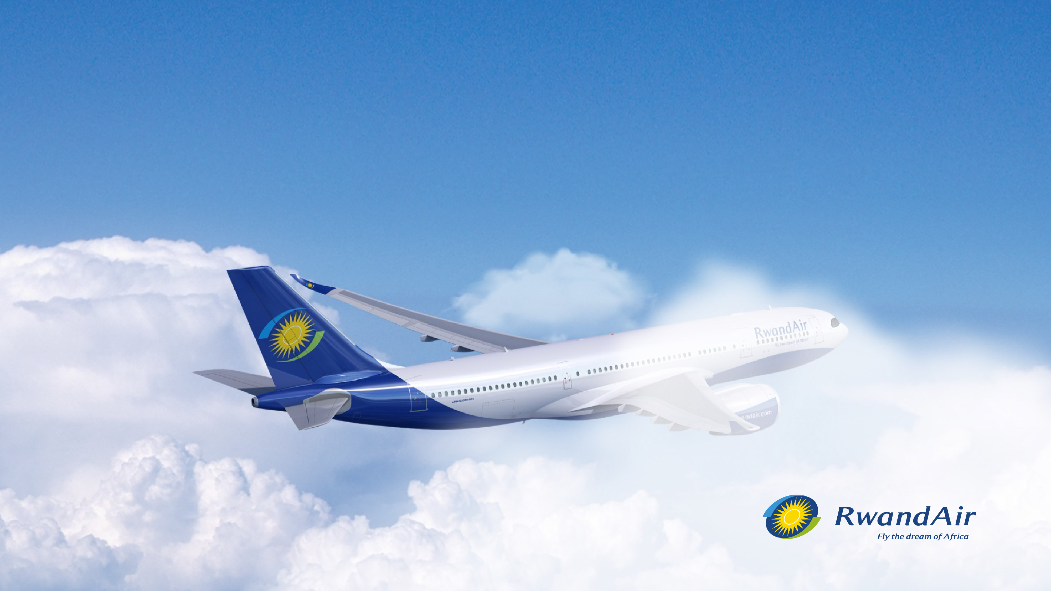
Launched in 2002 and based in Kigali,
RwandAir is Rwanda's national airline and one of the world’s fastest-growing carriers. With one of the youngest fleets in Africa, RwandAir has a modern fleet of 14 aircrafts, including a freighter servicing 24 destinations across Africa, Europe, and the Middle East.
Chief Executive Officer: Yvonne Manzi Makolo
Worldwide network: Over 23 destinations

Slide 3
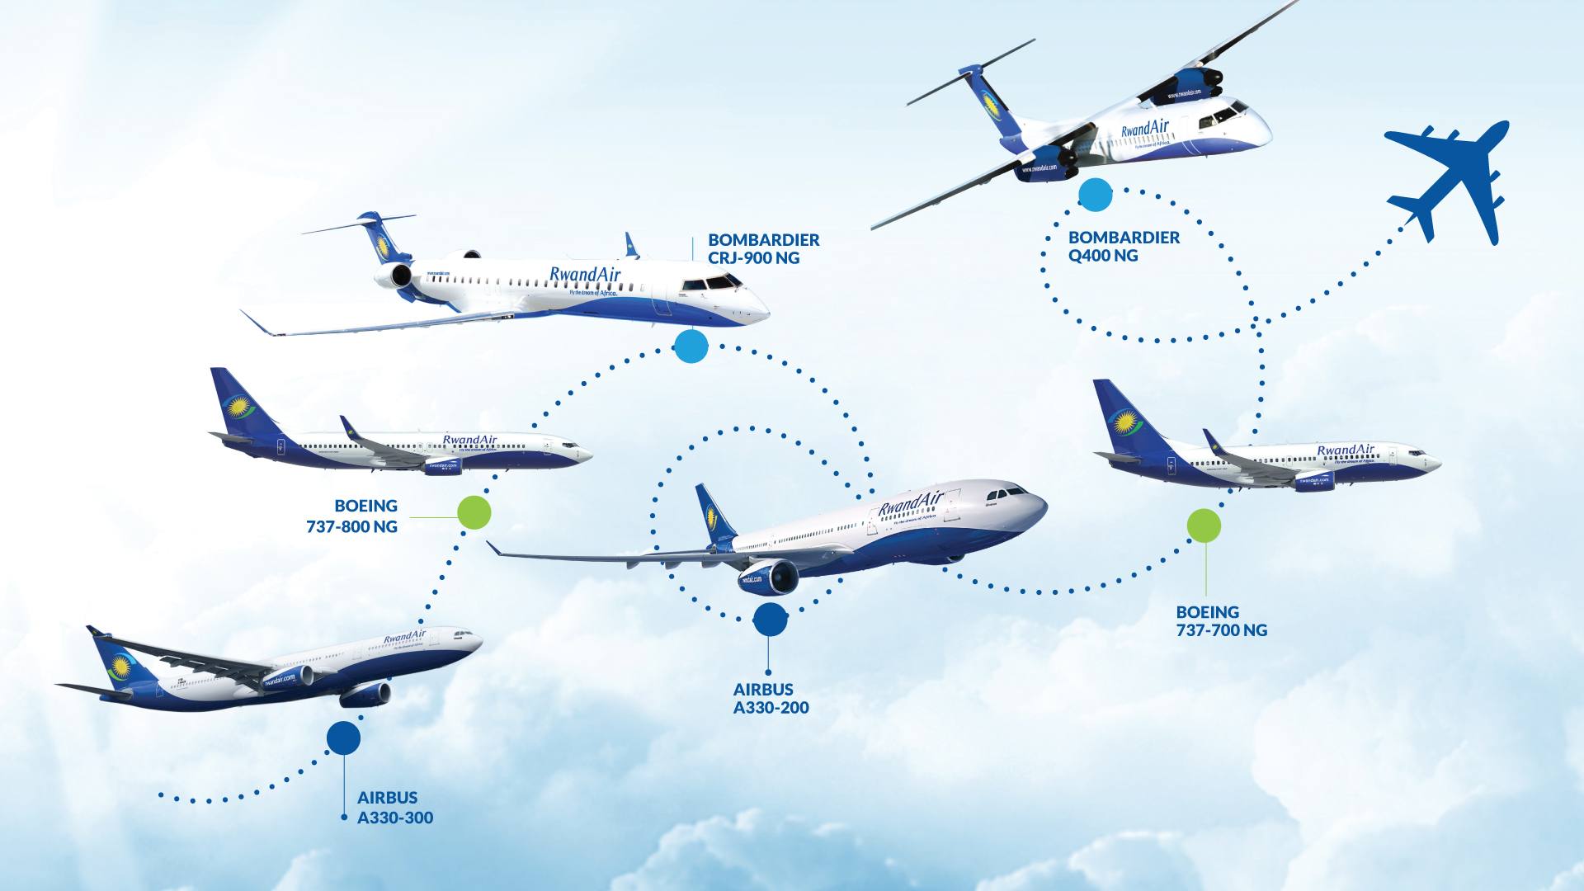
Current Fleet (Passenger and Cargo): 14 aircrafts

Slide 4



Highlights of 2024
Daily non stop flights from Kigali to London
RwandAir Cargo launched services to Dubai World Central (DWC) and Djibouti (DJI).

Slide 5
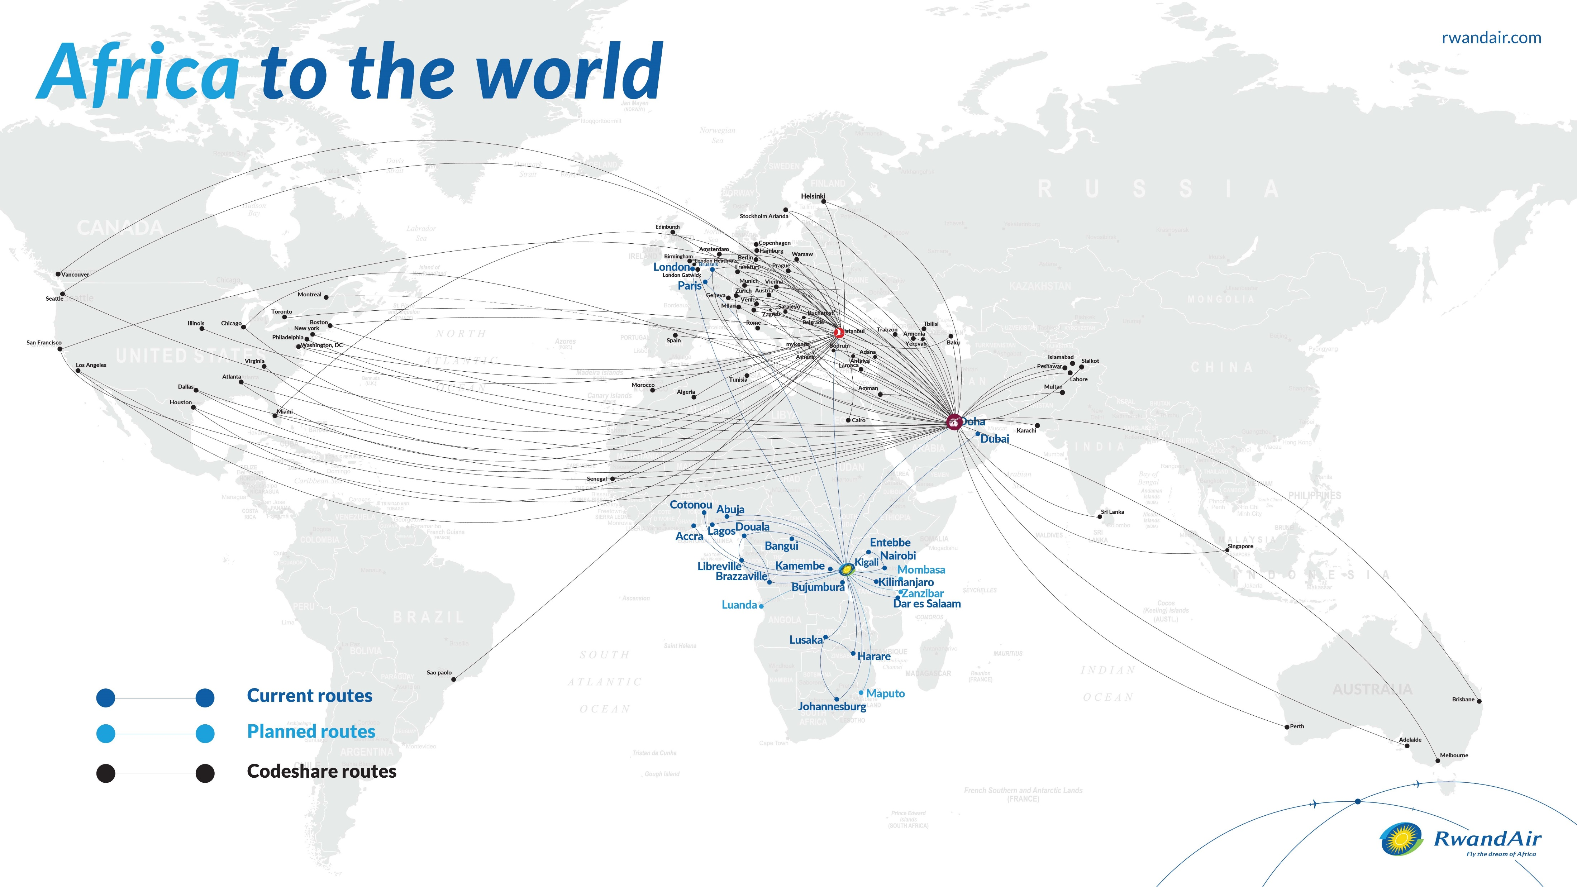
Current destinations (Passenger) - 23
  Africa – 18 : Kigali, Kamembe, Nairobi, Entebbe, Bujumbura, Kilimanjaro, Dar Es Salaam, Brazzaville, Cotonou, Libreville, Bangui, Douala, Abuja, Lagos, Accra, Lusaka, Johannesburg, and Harare.
  Middle – 2: Doha, Dubai
  Europe – 3: Paris, Brussels, and London

Slide 6
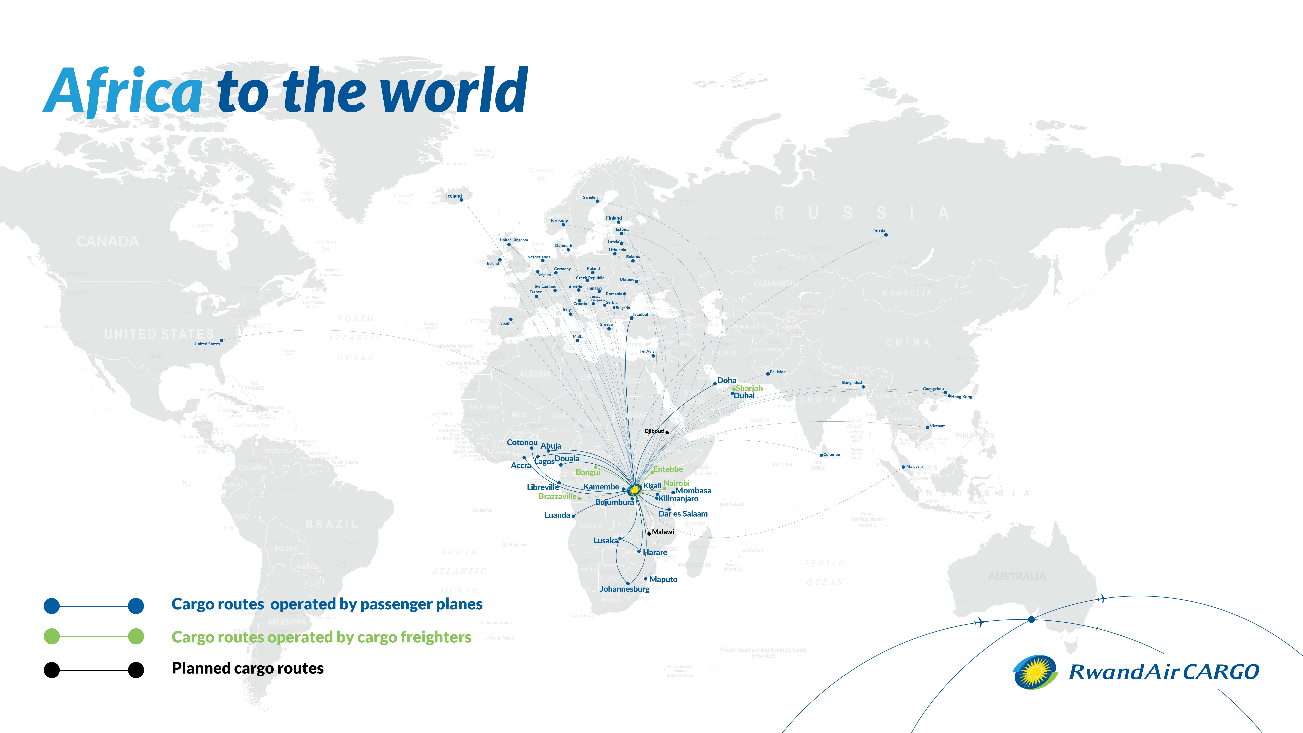
Current Cargo Destinations – 8
We operate dedicated freighters to Brazzaville, Kigali, Nairobi, Sharjah, Djibouti, Dubai World Central, Entebbe & Bangui.

Slide 7

Partners
Loyalty program – Qatar Airways
RwandAir’s loyalty members, “DreamMiles,” can earn and redeem miles to more than 170 destinations on Qatar Airways.
Codeshare partners – Qatar Airways
RwandAir’s passengers can seamlessly book and connect on Qatar’s 64 destinations worldwide.

Slide 8


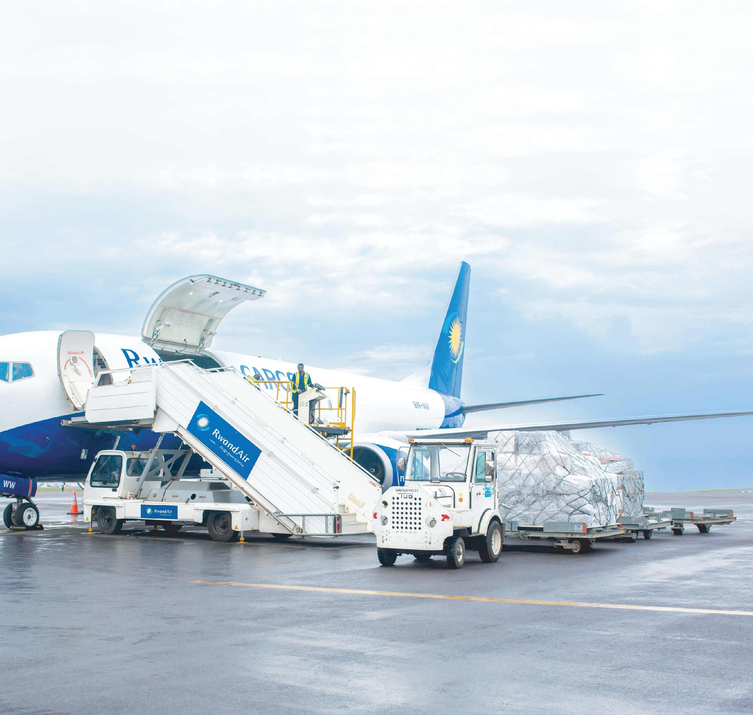
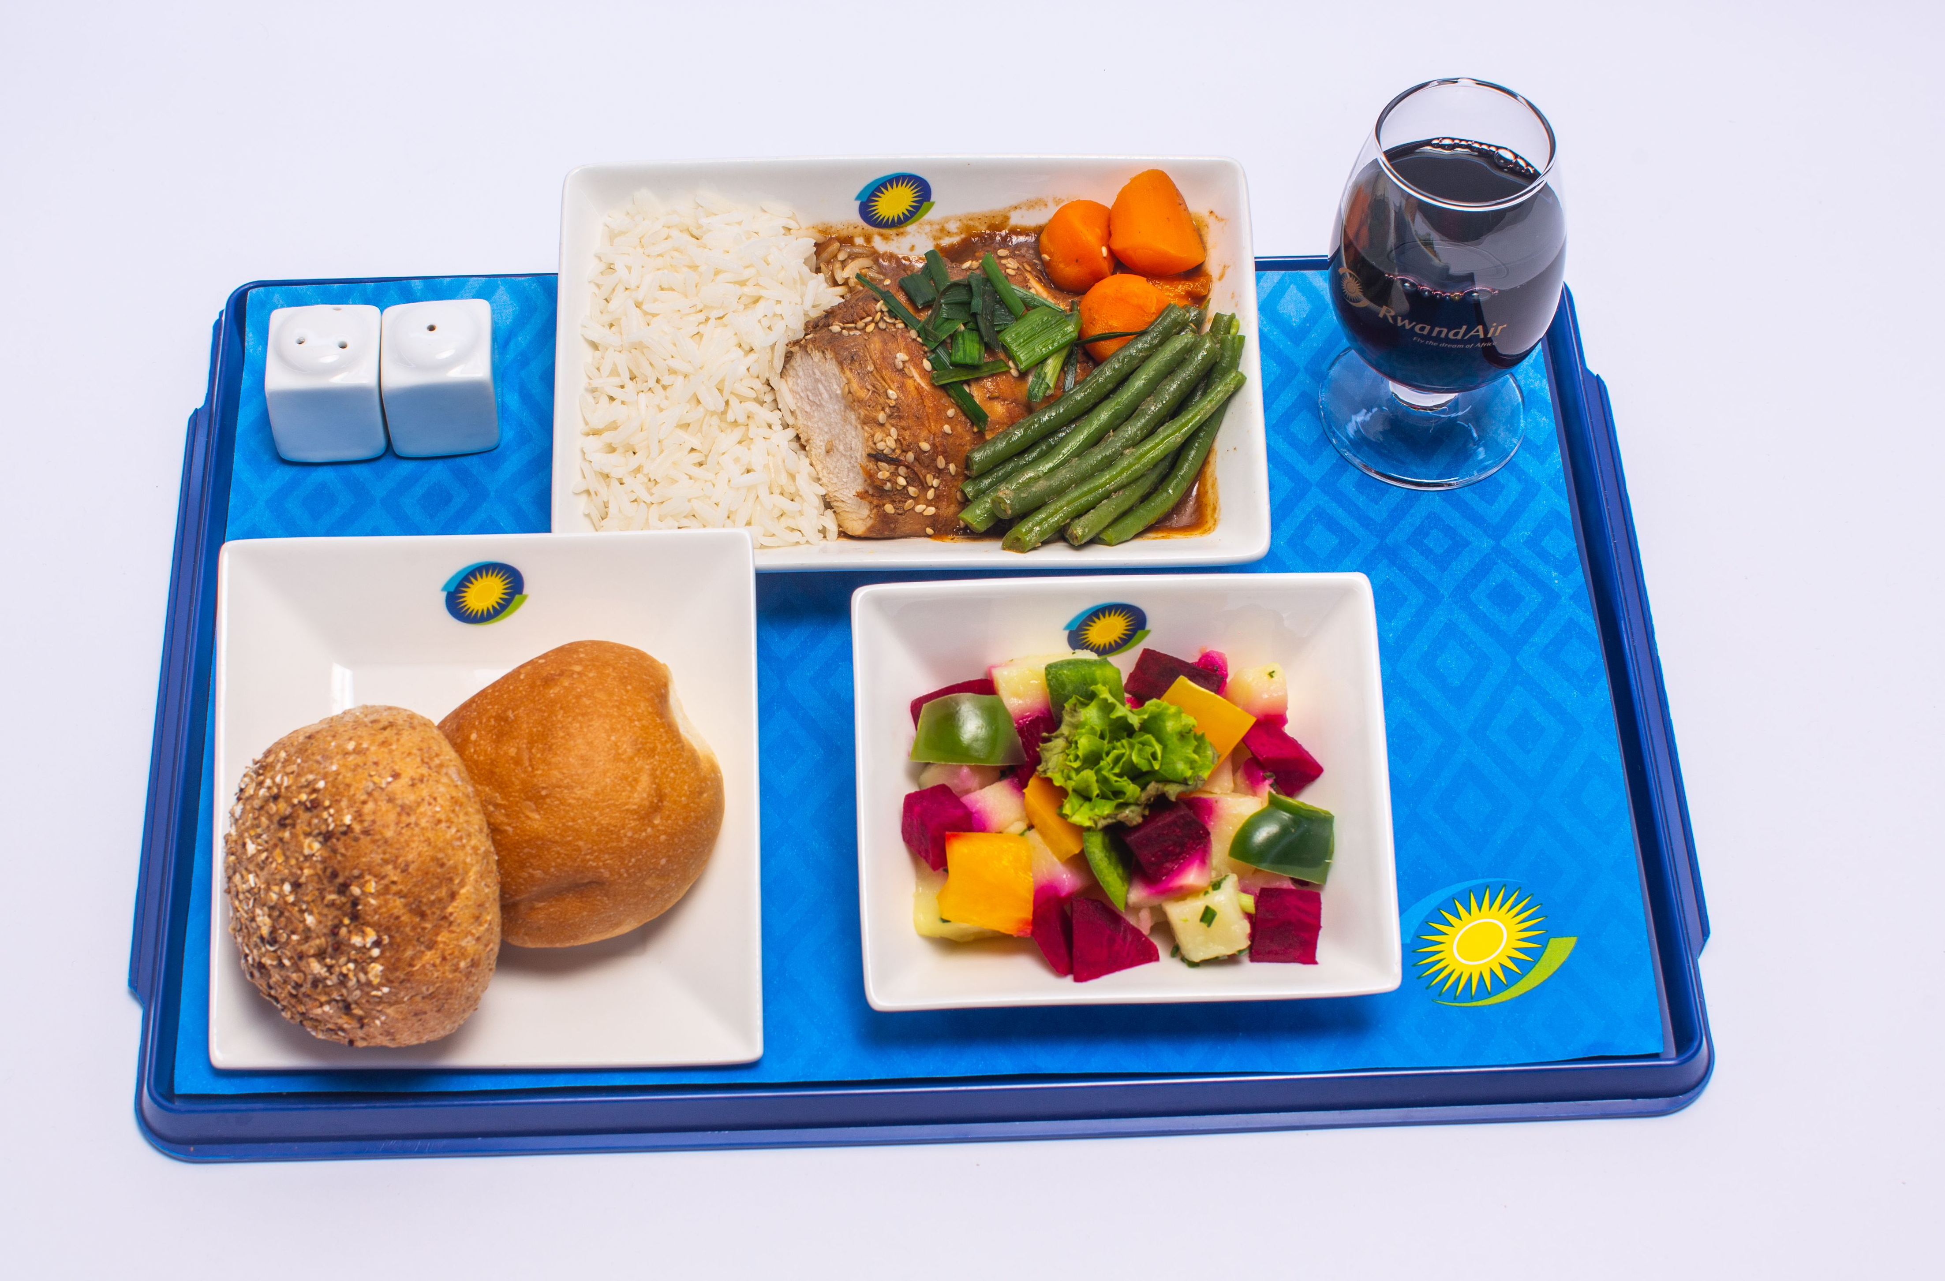
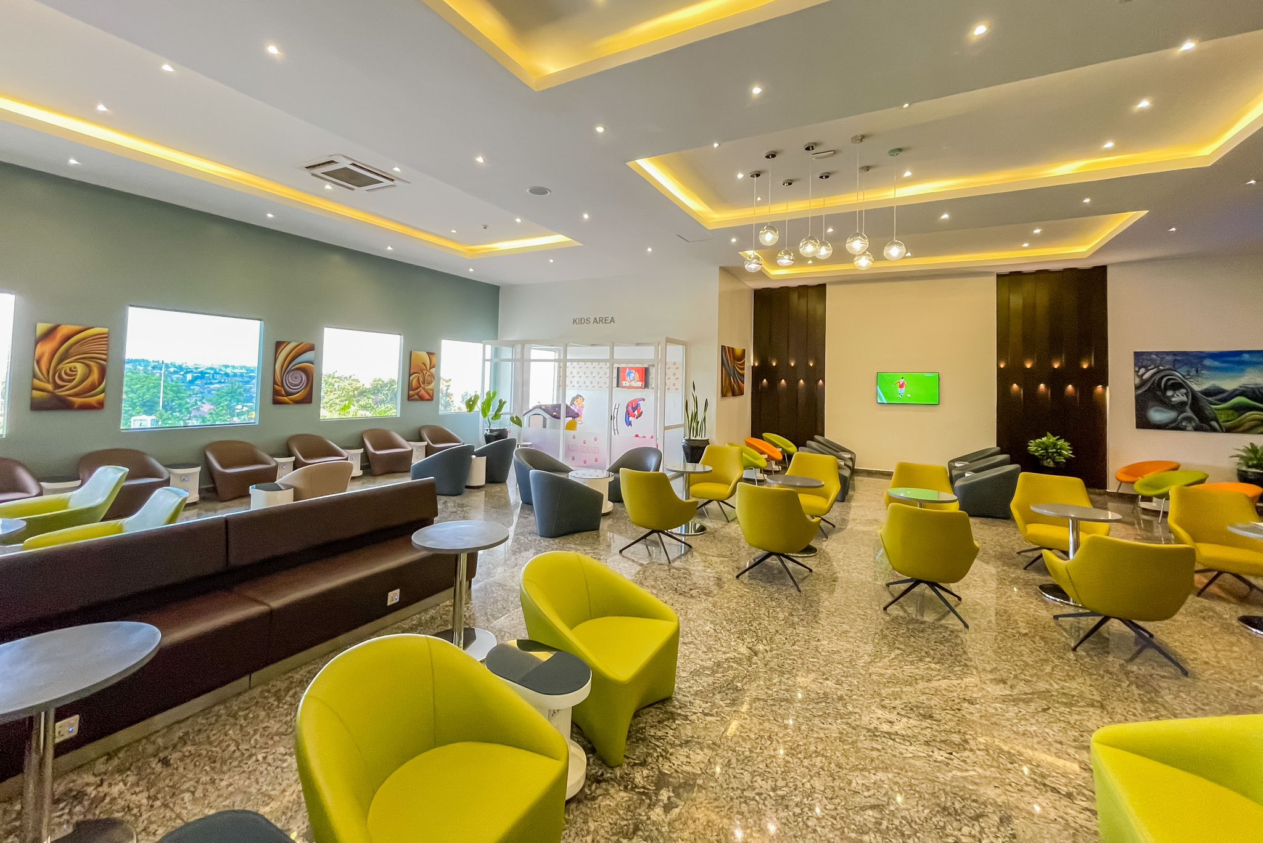
RwandAir Affiliated Companies
Dream Lounge
Dream Lounge is an exclusive airport lounge at Kigali International Airport, offering comfortable seating, complimentary refreshments, high-speed Wi-Fi, local and international cuisine, charging stations, entertainment options, and quiet areas for relaxation.
RwandAir Cargo provides an extensive range of cargo solutions in the most secure, swift & safest way across East, Central, West, Southern Africa, the Middle East and Europe.
RwandAir Catering Ltd is a rapidly growing in-flight catering company in Rwanda, providing services to scheduled airlines, private jets, and charters since August 2014. It aims to become one of the largest aviation catering companies in Africa.

Slide 9


Future Outlook
RwandAir plans to double its fleet in the next 5 years and expand its cargo network to export fresh produce and import essential goods.
Upcoming routes:-
Maputo
Mombasa
Zanzibar

Slide 10

THANK YOU
rwandair.com

